Slide 1

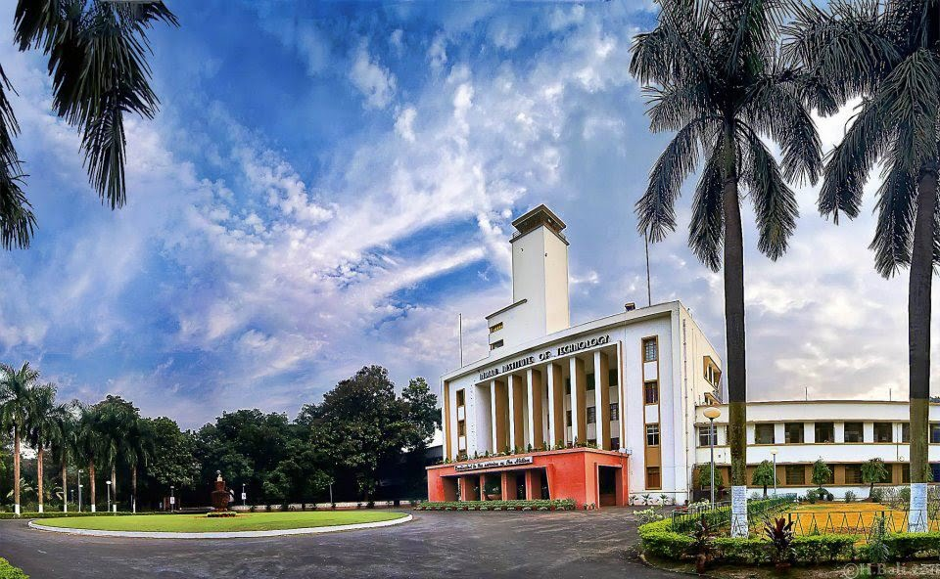
Green Integration as a new dimension of Supply Chain Classification for Strategic Analyses and Emission Control: A MILP approach
Department of Industrial and Systems Engineering, IIT Kharagpur
International Conference on Industrial Engineering & Analytics (ICONIEA) 2024
Track 2: Operations Management
Santanu Banerjee¹, Amit Kumar Singh¹, Pranav Sanjay Gore^{2,1,*}, Thiruchitrambalam B^{3,1,*}, Ankit Patel^{4,1,*}
¹ Department of Industrial and Systems Engineering, Indian Institute of Technology Kharagpur, India
² Product Engineer, Terex India Pvt. Ltd.
³ Logistics and Materials Handling, Production Engg. Dept., TVS Motor Company Pvt. Ltd.
Analytic Consulting – Associate, FICO, India
*Equal Contribution

Slide 2
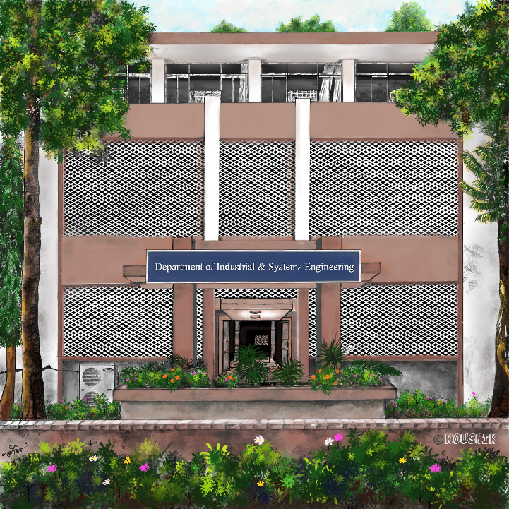
Department of Industrial and Systems Engineering, IIT Kharagpur
International Conference on Industrial Engineering & Analytics (ICONIEA) 2024
Green Integration as a new dimension of Supply Chain Classification for Strategic Analyses and Emission Control: A MILP approach
Presented by:
Santanu Banerjee
MS & SRF, Department of Industrial and Systems Engineering (ISE), Indian Institute of Technology (IIT) Kharagpur, Kharagpur 721 302, West Bengal, India.

Slide 3
Introduction
Supply chains are an essential part of present day mass-consumerism
Developing sustainable supply chains by green emission-less component integration is possibly the best way to curb emissions but breakthrough technological advancements is necessary to push this transformation alongwith government mandates
An alternative approach, especially keeping technological limitations in mind, would be the effective integration of supply chains with the optimization goal being minimization of the overall emissions
Flynn, Huo, & Zhao (2010) talks about incompleteness in the definition of SCI focusing on the missing link of internal integration and showed that customer and internal integration are related more strongly to performance improvement.
Fawcett & Magnan (2002) point out a theoretical utopia during the management of supply chains which are hard to replicate in real world, due to which few companies actually engage in SCI due to the need for collaborative efforts.

Slide 4
Concise Literature Review mentioning few salient points
Singh, et al. (2008): Road transportation accounts for 35% of total liquid-commercial-fuel consumed by all Indian sectors.
Syed Masiur Rahman (2017): Mention challenges in mitigating GHG emissions
Dhar & Shukla (2015): Dimensions of policy making regarding aspects of energy security, local environment and climate change with a feasible approach to achieving developmental objectives with CO₂ co-benefits
Jiang et al. (2019): Policies like cap and trade as is being used for constraining emissions has major limitations including that of significantly affecting supply chain companies' decisions about reducing carbon emissions

Slide 5
Our Problem and Approach
We model a SCI problem, while also considering a small part of the facility location problem:
There are main sources as Suppliers,
final sinks as Customers,
and other intermediate facilities (which may or may not be used).
Objective:
The facility location problem has long been studied with focus on the cost / time aspect of location, transportation and inventory management
We focus on reducing overall emissions Here the usage of a facility is a decision contributing to emissions within a supply chain No usage of a particular facility is also a feasible decision

Slide 6
Problem Description
We model our variant of the problem considering the following features:
The requirement of a facility to being open is a decision (to save on its emissions)
We consider a four-level network consisting of the following stages (sets):
Suppliers (S)
Distribution Centres (R)
Branches (B)
Customers (C)
All commodity flow happens in similar sequence, i.e. from S to R, from R to B, and from B to C. We also allow two other transportation routes, from S to B, and from R to C.
Figure 1: Inter-Set connections available for transportation

Slide 7
Problem Description (Contd.)
We consider both fixed as well as load-based variable emissions at each R and B.
We consider a single type of vehicle on the transportation network, and further consider any inter-stage transportation to be done by a unique vehicle (not considering any intra-stage transportations and thereby doing away with the complexity of modelling vehicle route planning). We assume that each transportation link (unique connection from one vertex to another) is catered to by a single vehicle of sufficient capacity (Q).
We model both fixed and load-and-distance based variable emission during transportation.

Slide 8
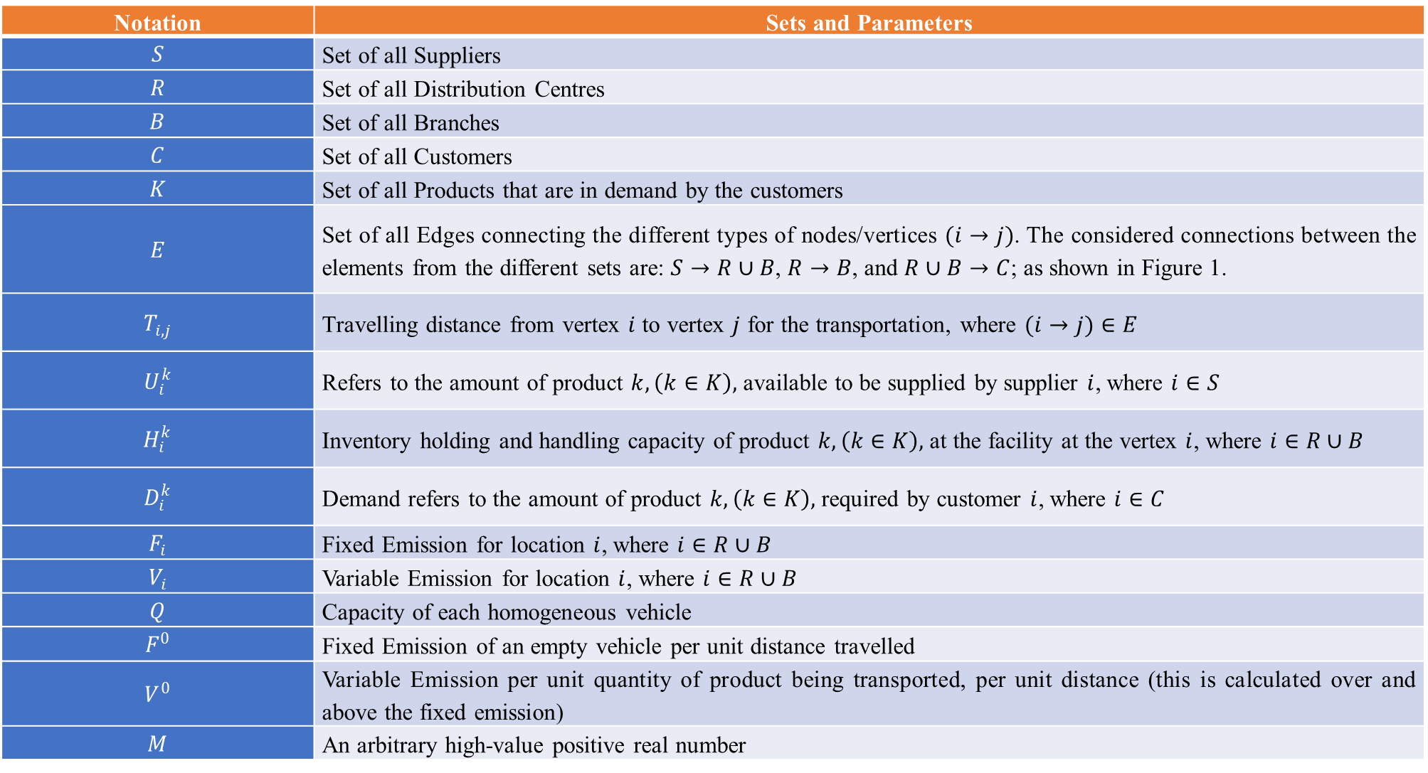
Table 1: Sets and Parameters used
Notation | Sets and Parameters
$$S$$ | Set of all Suppliers
$$R$$ | Set of all Distribution Centres
$$B$$ | Set of all Branches
$$C$$ | Set of all Customers
$$K$$ | Set of all Products that are in demand by the customers
$$E$$ | Set of all Edges connecting the different types of nodes/vertices $(i→j)$. The considered connections between the elements from the different sets are: $S→R∪B$, $R→B$, and $R∪B→C$; as shown in Figure 1.
$$T_{i,j}$$ | Travelling distance from vertex $i$ to vertex $j$ for the transportation, where $(i→j)∈E$
$$U_{i}^{k}$$ | Refers to the amount of product $k, \left(k∈K\right),$ available to be supplied by supplier $i$, where $i∈S$
$$H_{i}^{k}$$ | Inventory holding and handling capacity of product $k, \left(k∈K\right),$ at the facility at the vertex $i$, where $i∈R∪B$
$$D_{i}^{k}$$ | Demand refers to the amount of product $k, \left(k∈K\right),$ required by customer $i$, where $i∈C$
$$F_{i}$$ | Fixed Emission for location $i$, where $i∈R∪B$
$$V_{i}$$ | Variable Emission for location $i$, where $i∈R∪B$
$$Q$$ | Capacity of each homogeneous vehicle
$$F^{0}$$ | Fixed Emission of an empty vehicle per unit distance travelled
$$V^{0}$$ | Variable Emission per unit quantity of product being transported, per unit distance (this is calculated over and above the fixed emission)
$$M$$ | An arbitrary high-value positive real number

Slide 9
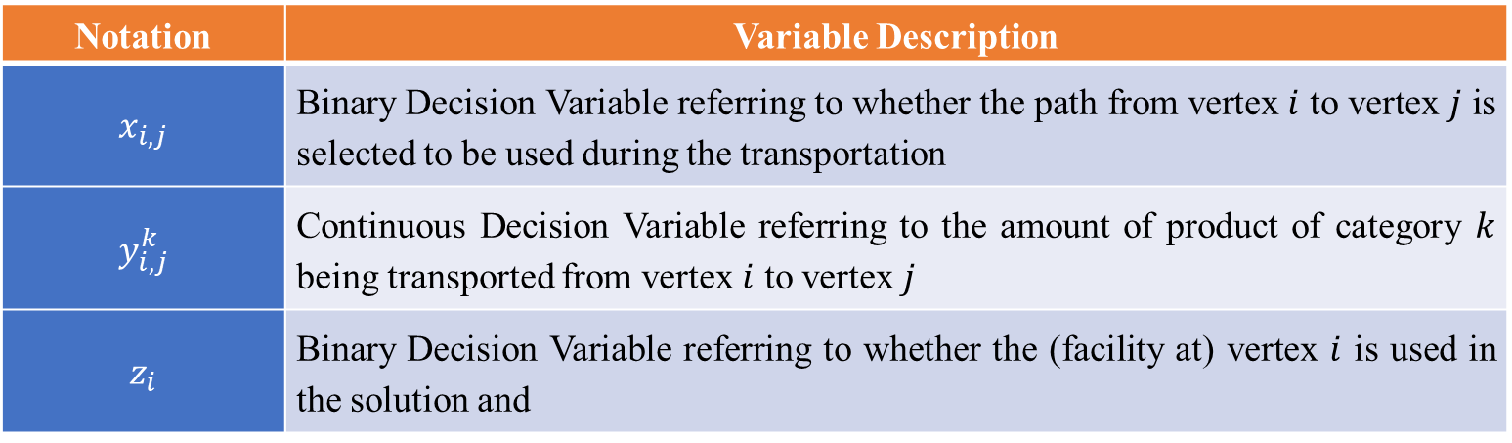
Table 2: Notations and Description of the Decision Variables used in the MILP Model
Notation | Variable Description
$$x_{i,j}$$ | Binary Decision Variable referring to whether the path from vertex $i$ to vertex $j$ is selected to be used during the transportation
$$y_{i,j}^{k}$$ | Continuous Decision Variable referring to the amount of product of category $k$ being transported from vertex $i$ to vertex $j$
$$z_{i}$$ | Binary Decision Variable referring to whether the (facility at) vertex $i$ is used in the solution and

Slide 10
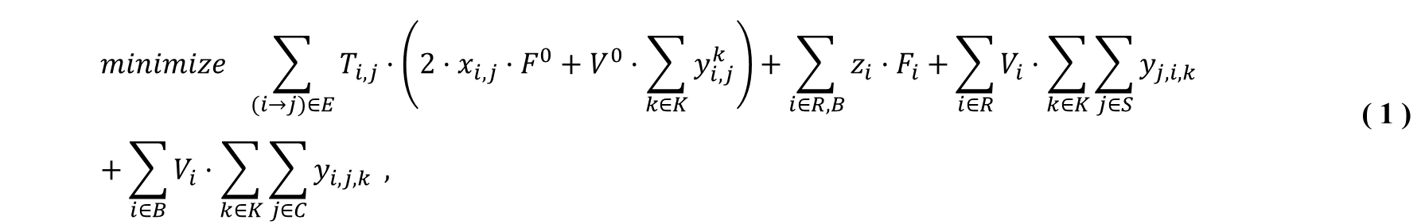
Mathematical Formulation
Objective Function (represents the total emission):
$$minimize \sum_{(i→j)∈E}{T_{i,j}·\left(2·x_{i,j}·F^{0}+V^{0}·\sum_{k∈K}{y_{i,j}^{k}}\right)}+\sum_{i∈R,B}{z_{i}·F_{i}}+\sum_{i∈R}{V_{i}·\sum_{k∈K}{\sum_{j∈S}{y_{j,i,k}}}}+\sum_{i∈B}{V_{i}·\sum_{k∈K}{\sum_{j∈C}{y_{i,j,k}}}} ,$$ | ( 1 )
First term represents the fixed emission and variable (as per load and distance) emission due to transportation of the loads.
The fixed emission, which represents the emission of the empty vehicle per unit distance travelled, is doubled due to vehicles’ (empty) return journey.
The second term represents the fixed emission from those Distribution Centres and Branches which are made to remain operational.
The last two terms represent the variable emissions (as the sum of emissions for handling each product) at the functional Distribution Centres and Branches respectively.

Slide 11
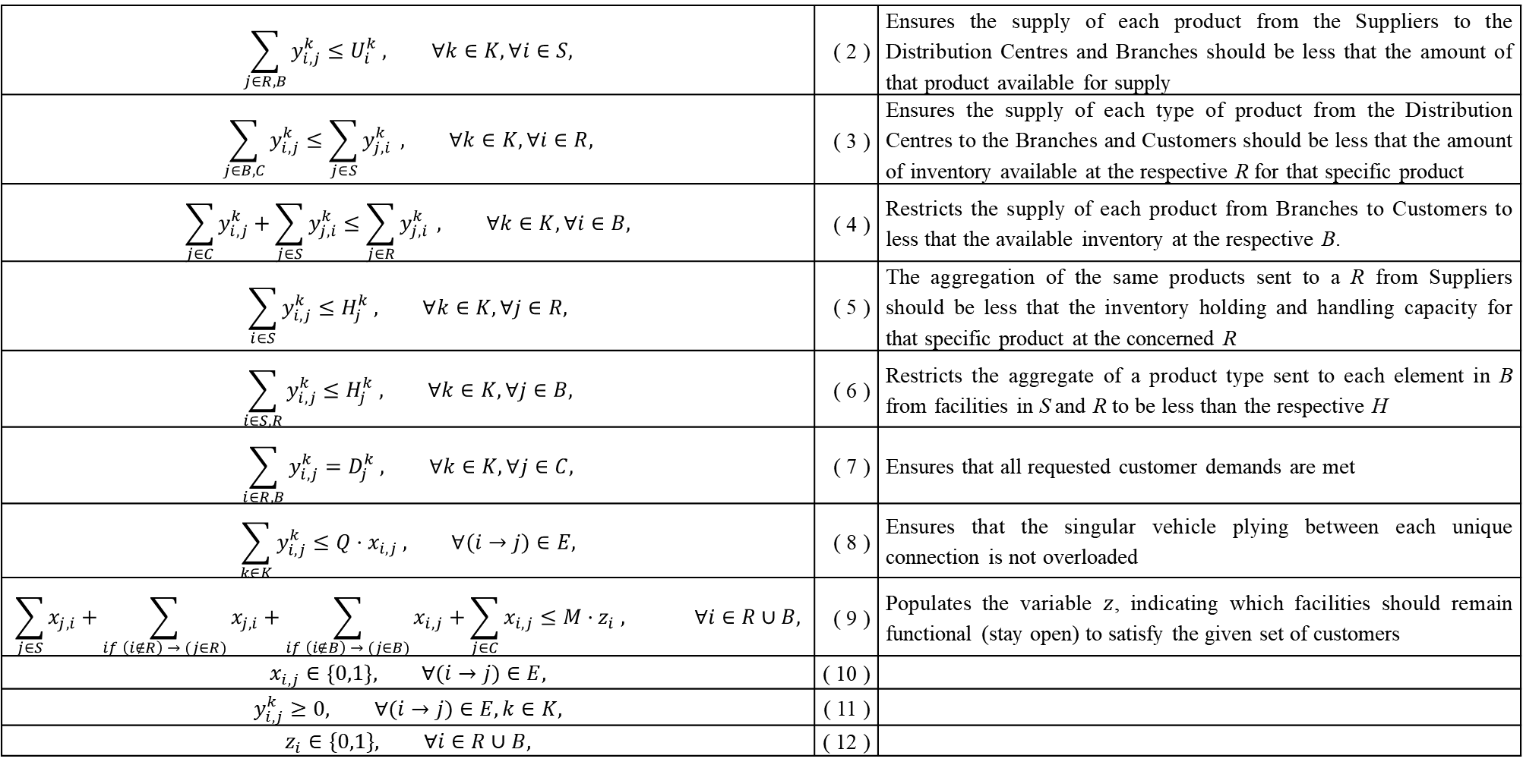
Constraints:
$$\sum_{j∈R,B}{y_{i,j}^{k}}≤U_{i}^{k} , ∀k∈K, ∀i∈S,$$ | ( 2 ) | Ensures the supply of each product from the Suppliers to the Distribution Centres and Branches should be less that the amount of that product available for supply
$$\sum_{j∈B,C}{y_{i,j}^{k}}≤\sum_{j∈S}{y_{j,i}^{k}} , ∀k∈K, ∀i∈R,$$ | ( 3 ) | Ensures the supply of each type of product from the Distribution Centres to the Branches and Customers should be less that the amount of inventory available at the respective R for that specific product
$$\sum_{j∈C}{y_{i,j}^{k}}+\sum_{j∈S}{y_{j,i}^{k}}≤\sum_{j∈R}{y_{j,i}^{k}} , ∀k∈K, ∀i∈B,$$ | ( 4 ) | Restricts the supply of each product from Branches to Customers to less that the available inventory at the respective B.
$$\sum_{i∈S}{y_{i,j}^{k}}≤H_{j}^{k} , ∀k∈K, ∀j∈R,$$ | ( 5 ) | The aggregation of the same products sent to a R from Suppliers should be less that the inventory holding and handling capacity for that specific product at the concerned R
$$\sum_{i∈S,R}{y_{i,j}^{k}}≤H_{j}^{k} , ∀k∈K, ∀j∈B,$$ | ( 6 ) | Restricts the aggregate of a product type sent to each element in B from facilities in S and R to be less than the respective H
$$\sum_{i∈R,B}{y_{i,j}^{k}}=D_{j}^{k} , ∀k∈K, ∀j∈C,$$ | ( 7 ) | Ensures that all requested customer demands are met
$$\sum_{k∈K}{y_{i,j}^{k}}≤Q·x_{i,j} , ∀(i→j)∈E,$$ | ( 8 ) | Ensures that the singular vehicle plying between each unique connection is not overloaded
$$\sum_{j∈S}{x_{j,i}}+\sum_{if \left(i∉R\right) → (j∈R)}{x_{j,i}}+\sum_{if \left(i∉B\right) → (j∈B)}{x_{i,j}}+\sum_{j∈C}{x_{i,j}}≤M·z_{i} , ∀i∈R∪B,$$ | ( 9 ) | Populates the variable $z$, indicating which facilities should remain functional (stay open) to satisfy the given set of customers
$$x_{i,j}∈\left\{0,1\right\}, ∀(i→j)∈E,$$ | ( 10 )
$$y_{i,j}^{k}≥0, ∀(i→j)∈E,k∈K,$$ | ( 11 )
$$z_{i}∈\{0,1\}, ∀i∈R∪B,$$ | ( 12 )

Slide 12
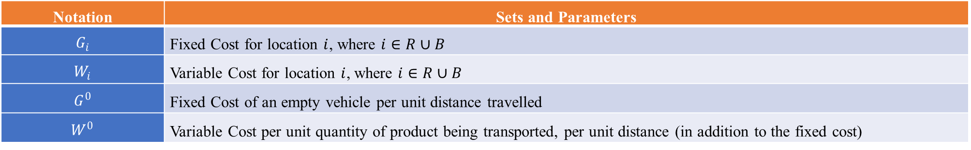
Results and Discussion
To compare with Cost minimization we further consider extra parameters available in Table 3.
Table 3: Notations of Sets for comparison of Cost Minimization w.r.t. Emission Minimization
Notation | Sets and Parameters
$$G_{i}$$ | Fixed Cost for location $i$, where $i∈R∪B$
$$W_{i}$$ | Variable Cost for location $i$, where $i∈R∪B$
$$G^{0}$$ | Fixed Cost of an empty vehicle per unit distance travelled
$$W^{0}$$ | Variable Cost per unit quantity of product being transported, per unit distance (in addition to the fixed cost)
We calculate the Cost of the entire operation using Eq. 13
Compare the difference in emissions w.r.t. changing objectives of Emission Reduction and Cost Minimization
We find considerable increase in emissions when the cost objective from Eq. 13 is used instead of minimizing the emissions (Eq. 1)
$$minimize \sum_{(i→j)∈E}{T_{i,j}·\left(2·x_{i,j}·G^{0}+W^{0}·\sum_{k∈K}{y_{i,j}^{k}}\right)}+\sum_{i∈R,B}{z_{i}·G_{i}}+\sum_{i∈R}{W_{i}·\sum_{k∈K}{\sum_{j∈S}{y_{j,i,k}}}}+\sum_{i∈B}{W_{i}·\sum_{k∈K}{\sum_{j∈C}{y_{i,j,k}}}} ,$$ | ( 13 )

Slide 13
Table 4: Results on a randomly generated dataset showing the progressively increasing savings in emissions as supply chains are integrated.
Integrated Supply Chains | |S| | |R| | |B| | |C| | |K| | No. of Homogeneous Vehicles available |E| | When minimizing the Emission Objective of Eq. 1 |  |  |  | Minimizing the Cost Objective of Eq. 13 |  |  |  | Increase in Emission when minimizing Cost instead of Emissions (c) #
 |  |  |  |  |  |  | Emission value (a) | Open Distribution Centres | No. of Open Branches | Vehicles used | Emission value (b) | No. of Open Distribution Centres | Open Branches | No. of Vehicles used
1 | 2 | 3 | 5 | 10 | 2 | 111 | 511.11 | 1 | 0 | 12 | 630.50 | 2 | 0 | 13 | 23.36 %
2 | 2 | 3 | 5 | 10 | 2 | 111 | 704.04 | 1 | 0 | 12 | 797.01 | 2 | 0 | 13 | 13.21 %
3 | 2 | 3 | 5 | 10 | 2 | 111 | 645.26 | 2 | 0 | 14 | 692.98 | 2 | 0 | 12 | 7.4 %
4 | 1 | 1 | 2 | 5 | 3 | 20 | 350.95 | 1 | 0 | 6 | 350.95 | 1 | 0 | 6 | 0 %
5 | 1 | 2 | 3 | 5 | 3 | 36 | 253.91 | 1 | 0 | 6 | 253.91 | 1 | 0 | 6 | 0 %
1,2 | 4 | 6 | 10 | 20 | 3 | 444 | 1170.95 | 2 | 0 | 27 | 1494.5 | 3 | 0 | 33 | 27.63 %
4,5 | 2 | 3 | 5 | 10 | 3 | 111 | 416.89 | 2 | 0 | 12 | 440.1 | 2 | 0 | 13 | 5.57 %
1,2,3 | 6 | 9 | 15 | 30 | 3 | 999 | 1756.48 | 3 | 0 | 44 | 2030.33 | 4 | 0 | 50 | 15.59 %
3,4,5 | 4 | 6 | 10 | 20 | 3 | 444 | 740.41 | 4 | 1 | 28 | 910.02 | 3 | 0 | 26 | 22.91 %
1,2,4,5 | 6 | 9 | 15 | 30 | 3 | 999 | 1002.63 | 3 | 1 | 42 | 1826.75 | 4 | 1 | 54 | 82.2 %
1,2,3,4,5 | 8 | 12 | 20 | 40 | 3 | 1776 | 1268.9 | 4 | 1 | 58 | 2229.25 | 5 | 0 | 64 | 75.68 %
# c = 100 · (b-a) / a
The dataset with the codes available online: https://github.com/SanTanBan/DataSet-ICONIEA-2024-Emission-Reduction-through-Green-Sustainable-Supply-Chains

Slide 14
Findings and Conclusion
We consider a few separate Maintenance, Repair and Operations (MRO) Supplies based supply chains for individual corporate entities
We show how integration of these supply chains would help reduce the total emission, w.r.t. the separate individual supply chains
The integration is done by adding together the sets of Suppliers, Distribution Centres, Branches and Consumers retaining their respective original parameters.
The results indicate that minimizing the individual costs of the five supply chains separately increases emissions by about 114.78% w.r.t. the case of minimizing the total emissions in the integrated supply chain (when all the five independent supply chains in Table 4 have been integrated into a single supply chain with all Suppliers being able to cater all Customers through the available inter-connections as shown in Figure 1 among the new integrated sets of Distribution Centres and Branches).
The dimension of Sustainability needs to be used for assessing performance in supply chains as well, expanding on the fundamental idea of classification of supply chains as Efficient and Responsive only. In this progressive era necessitating enormous climate action, previous performance analysis parameters are insufficient and evolution of each type of supply chain, improving over the classical approaches, is shown in Table 5.

Slide 15
Table 5: Increasing Scope of Supply Chain Classification to enable achievement of Optimal Strategic Fit

Slide 16
Future Work
Expanding the current modelling assumption of each transportation link being catered to by a single vehicle to allow multiple heterogeneous vehicles to ply on the network
We believe that instead of further developing random variables for the parameters considered for our and similar problems to develop and compare stochastic programming approaches towards emission reduction, real world case studies would reveal the actual potential of clubbing independent supply chains into a single green entity; and definitely show magnitudes of emission reduction, much more than reported by us for the single holistic green integration with random parameter values.
Accounting for temporal causality, especially during consideration of the inventory holding and handling capacities. Currently the model assumes that the entire process of obtaining the loads from appropriate transportation networks into the facilities happens at once. The capacity constraint for the facilities, to not exceed above their respective value of H, could be improved since all the loading unloading process does not take place at the same time in reality, and therefore the facilities may not get overwhelmed easily.
Multiple emission parameters should be further considered (instead of a single type to emission) and weighing these different types of emissions with their respective GWPs to obtain a cumulative objective function would enable minimization of GWP for the integrated supply chain.

Slide 17
REFERENCES
Adana, S., Manuj, I., Herburger, M., Cevikparmak, S., Celik, H., & Uvet, H. (2024, January 14). Linking decentralization in decision-making to resilience outcomes: a supply chain orientation perspective. The International Journal of Logistics Management, 35(1), 256-280. doi:10.1108/IJLM-07-2022-0308
Ageron, B., Gunasekaran, A., & Spalanzani, A. (2012). Sustainable supply management: An empirical study. International Journal of Production Economics, 140(1), 168-182. doi:10.1016/j.ijpe.2011.04.007
Agrawal, A. K., & Yadav, S. (2020). Price and profit structuring for single manufacturer multi-buyer integrated inventory supply chain under price-sensitive demand condition. Computers & Industrial Engineering, 139, 106208. doi:10.1016/j.cie.2019.106208
Awad, H. A., & Nassar, M. O. (2010). Supply Chain Integration: Definition and Challenges. Proceedings of the International MultiConference of Engineers and Computer Scientists 2010, I. Hong Kong. Retrieved from https://www.kau.edu.sa/Show_Res.aspx?Site_ID=857&LNG=EN&RN=58325
Bagchi, P. K., Chun Ha, B., Skjoett‐Larsen, T., & Boege Soerensen, L. (2005). Supply chain integration: a European survey. The International Journal of Logistics Management, 16(2), 275-294. doi:10.1108/09574090510634557
Das, S. K., Yu, V. F., Roy, S. K., & Weber, G. W. (2024). Location–allocation problem for green efficient two-stage vehicle-based logistics system: A type-2 neutrosophic multi-objective modeling approach. Expert Systems with Applications, 238, 122174. doi:10.1016/j.eswa.2023.122174
Dhar, S., & Shukla, P. R. (2015). Low carbon scenarios for transport in India: Co-benefits analysis. Energy Policy, 81, 186-198. doi:10.1016/j.enpol.2014.11.026
Dubey, R., Gunasekaran, A., Childe, S. J., Papadopoulos, T., & Fosso Wamba, S. (2017). World class sustainable supply chain management: critical review and further research directions. The International Journal of Logistics Management, 28(2), 332-362. doi:10.1108/IJLM-07-2015-0112
Fabbe‐Costes, N., & Jahre, M. (2008). Supply chain integration and performance: a review of the evidence. (M. Waller, Ed.) The International Journal of Logistics Management, 19(2), 130-154. doi:10.1108/09574090810895933
Fawcett, S. E., & Magnan, G. M. (2002, 01 01). The rhetoric and reality of supply chain integration. International Journal of Physical Distribution & Logistics Management, 32(5), 339-361. doi:10.1108/09600030210436222
Flynn, B. B., Huo, B., & Zhao, X. (2010). The impact of supply chain integration on performance: A contingency and configuration approach. Journal of Operations Management, 28(1), 58-71. doi:https://doi.org/10.1016/j.jom.2009.06.001
Gunasekaran, A., & Ngai, E. (2004). Information systems in supply chain integration and management. European Journal of Operational Research, 159(2), 269-295. doi:10.1016/j.ejor.2003.08.016
Hosseini-Motlagh, S.-M., Choi, T.-M., Johari, M., & Nouri-Harzvili, M. (2022). A profit surplus distribution mechanism for supply chain coordination: An evolutionary game-theoretic analysis. European Journal of Operational Research, 301(2), 561-575. doi:10.1016/j.ejor.2021.10.059
Huang, C.-H. (2012). Design and Development of Wireless Power Transmission for Unmanned Air Vehicles. Master's Thesis, Naval PostGraduate School Monterey CA. doi:https://apps.dtic.mil/sti/citations/ADA567672
Jiang, W., Lu, W., & Xu, Q. (2019). Profit Distribution Model for Construction Supply Chain with Cap-and-Trade Policy. Sustainability, 11(4), 1215. doi:10.3390/su11041215
Jiang, W., Wei, M., & Wu, W. (2019, September). Profit Distribution Strategy of Cooperation Construction Supply Chain under Carbon Tax Policy. IOP Conference Series: Earth and Environmental Science, 304(3), 032110. doi:10.1088/1755-1315/304/3/032110
Jiang, W., Yuan, L., Wu, L., & Guo, S. (2019, October). Carbon emission reduction and profit distribution mechanism of construction supply chain with fairness concern and cap-and-trade. PLOS ONE, 14(10), 1-23. doi:10.1371/journal.pone.0224153

Slide 18
REFERENCES (Contd.)
Kumar, A., Mangla, S. K., Kumar, P., & Karamperidis, S. (2020). Challenges in perishable food supply chains for sustainability management: A developing economy perspective. Business Strategy and the Environment, 29(5), 1809-1831. doi:10.1002/bse.2470
Kumar, S., Raut, R. D., Aktas, E., Narkhede, B. E., & Gedam, V. V. (2023). Barriers to adoption of industry 4.0 and sustainability: a case study with SMEs. International Journal of Computer Integrated Manufacturing, 36(5), 657-677. doi:10.1080/0951192X.2022.2128217
Li, G., Yang, H., Sun, L., & Sohal, A. S. (2009). The impact of IT implementation on supply chain integration and performance. International Journal of Production Economics, 120(1), 125-138. doi:10.1016/j.ijpe.2008.07.017
Lu, T., Lü, F., Liao, N., Chai, H., Zhang, H., & He, P. (2024). Material flow analysis and global warming potential assessment of an industrial insect-based bioconversion plant using housefly larvae. Journal of Environmental Sciences, 139, 483-495. doi:10.1016/j.jes.2023.05.007
Mani, A., Budd, T., & Maine, E. (2024). Emissions-Intensive and Trade-Exposed Industries: Technological Innovation and Climate Policy Solutions to Achieve Net-Zero Emissions by 2050. RSC Sustainability. doi:10.1039/D3SU00335C
Rosu, F., & Badescu, A. (2021). Electric and Magnetic Design of a Deployable WPT System for Industrial and Defense UAV Applications. Electronics, 10(18), 2252. doi:10.3390/electronics10182252
Sadeghi, M., Nikfar, M., & Rad, F. M. (2024). Optimizing warehouse operations for environmental sustainability: A simulation study for reducing carbon emissions and maximizing space utilization. Journal of Future Sustainability, 4(1), 35-44. doi:10.5267/j.jfs.2024.1.004
Sgarbossa, F., & Russo, I. (2017). A proactive model in sustainable food supply chain: Insight from a case study. International Journal of Production Economics, 183, 596-606. doi:10.1016/j.ijpe.2016.07.022
Shin, J., Shin, S., Kim, Y., Ahn, S., Lee, S., Jung, G., . . . Cho, D.-H. (2014). Design and Implementation of Shaped Magnetic-Resonance-Based Wireless Power Transfer System for Roadway-Powered Moving Electric Vehicles. IEEE Transactions on Industrial Electronics, 61(3), 1179-1192. doi:10.1109/TIE.2013.2258294
Simatupang, T. M., Wright, A. C., & Sridharan, R. (2002). The knowledge of coordination for supply chain integration. Business Process Management Journal, 8(3), 289-308. doi:10.1108/14637150210428989
Singh, A., Gangopadhyay, S., Nanda, P., Bhattacharya, S., Sharma, C., & Bhan, C. (2008). Trends of greenhouse gas emissions from the road transport sector in India. Science of The Total Environment, 390(1), 124-131. doi:10.1016/j.scitotenv.2007.09.027
Sonar, H., Ghag, N., Kharde, Y., & Ghosh, S. (2023). Analysis of barriers affecting circular economy adoption in food supply chain: A strategic perspective. Business Strategy and the Environment, 32(8), 5273-5288. doi:10.1002/bse.3416
Sonar, H., Mukherjee, A., Gunasekaran, A., & Singh, R. K. (2022). Sustainable supply chain management of automotive sector in context to the circular economy: A strategic framework. Business Strategy and the Environment, 31(7), 3635-3648. doi:10.1002/bse.3112
Syed Masiur Rahman, A. K. (2017). Greenhouse gas emissions from road transportation in Saudi Arabia - a challenging frontier. Renewable and Sustainable Energy Reviews, 69, 812-821. doi:10.1016/j.rser.2016.11.047
Uttam, N., Dutta, P., & Singh, A. (2022). Micro, small, and medium suppliers' perspectives on supply chain social sustainability: New evidence from India. Journal of Cleaner Production, 379, 134473. doi:10.1016/j.jclepro.2022.134473
van der Vaart, T., & van Donk, D. P. (2008). A critical review of survey-based research in supply chain integration. International Journal of Production Economics, 111(1), 42-55. doi:10.1016/j.ijpe.2006.10.011
Wofuru-Nyenke, O. (2023, October 9). Routing and facility location optimization in a dairy products supply chain. Future Technology, 3(2), 44–49. Retrieved from https://fupubco.com/futech/article/view/127
Xing, C., Liu, C., Lin, J., Tan, W., & Liu, T. (2024). VOCs hyperspectral imaging: A new insight into evaluate emissions and the corresponding health risk from industries. Journal of Hazardous Materials, 461, 132573. doi:10.1016/j.jhazmat.2023.132573
Zhang, J.-H., Yin, R.-R., Zhang, J., & Nie, M.-J. (2014, June 16). The Profit Distribution of Supply Chain under E-Commerce. (X. Sun, Ed.) Discrete Dynamics in Nature and Society, 2014, 287925. doi:10.1155/2014/287925
Zhang, Y., & Geng, H. (2012). An Analysis on Distribution of Cooperative Profit in Supply Chain Based on Multi-Agent. Physics Procedia, 33, 698-704. doi:10.1016/j.phpro.2012.05.123

Slide 19
Supply Chain Integration is essential towards metamorphosing our current economy driven society into being climate conscious; allowing us to take the path of sustainability for our civilization’s longevity; this would involve good policy implementations through extensive policy research.
Thank You!
This presentation will be hosted alongwith the online dataset and code for ease of future researchers towards furthering scientific exploration: https://github.com/SanTanBan/DataSet-ICONIEA-2024-Emission-Reduction-through-Green-Sustainable-Supply-Chains
santanu@kgpian.iitkgp.ac.in,
amit2021@kgpian.iitkgp.ac.in, pranavgore256@kgpian.iitkgp.ac.in, thirubaskkaran@kgpian.iitkgp.ac.in, ankitsinghpatel@gmail.com

